Slide 1
Xi Han
XIHAN1@gmail.com
https://axihixa.github.io/

Slide 2
Personal information
Basic Information
Male, born in 1997.
Family in Beijing.
Currently studying in New York, United States.
Educational Background
2019-Now: Ph.D. (in progress) in Computer Science (Stony Brook University, New York, United States).
2015-2019: B.E. in Computer Science and Technology (Tsinghua University, Beijing, China).

Slide 3
Skills And Professionalism
TL;DR.
C/C++/CUDA/PTX, GPU Algorithms, Mamba, PDEs, Computer Graphics, Machine Learning.
Languages:
Expert in: C/C++, CUDA (including PTX), and Python;
Familiar with: Assembly, CMake, Bash, Java, MATLAB, Objective C/C++, and Swift.
Tools and Framework:
PyTorch (including C++/CUDA extensions and PyTorch profiler);
NVIDIA Nsight Compute, Nsight Systems, Compute Sanitizer, and CUDA-GDB;
OpenGL.
Research Areas:
Computer Graphics (Physics-based modeling, Vector Graphics, and Animation);
Numerical Analysis (PDEs);
AI/HPC (Operator optimization/fine-tuning, and performance profiling).

Slide 4
Overview
Research Projects:
UGrid: Neural PDE solver with convergence guarantee (ICML 2024).
2DMamba: 2D Mamba scanner with hardware awareness and applications in image processing (CVPR 2025).
LBMamba: Bidirectional Mamba scanner with hardware awareness and apps. In image processing (Under review).
GeoMaNO: Geometry and hardware-aware Mamba Neural Operator for solving PDEs (Under review).
DPR: Differentiable Poisson solver with hardware awareness and apps. in Computer Graphics (Ongoing).
Other Projects:
Fine-tuning of multiple AI/ML/GPU operators (CUDA kernels).

Slide 5
Ugrid: An Efficient-And-Rigorous Neural PDE Solver (ICML 2024)
TL;DR: UGrid is a neural solver for Partial Differential Equations (PDEs) with convergence guarantee. Motivation: Numerical solvers of PDEs are of fundamental significance to science and engineering.
Legacy routines fail to incorporate big data knowledge, thus suffer from sub-optimal efficiency;
Black-box-like neural methods provide no guarantee of convergence.

Slide 6
Ugrid: An Efficient-And-Rigorous Neural PDE Solver (ICML 2024)
We propose a novel neural routine with mathematical rigor, strong generalization power, high efficiency, high accuracy and high robustness.
It manifests a mathematically rigorous proof of both convergence and correctness;
It showcases high numerical accuracy, as well as strong generalization power to various input geometry/values and multiple PDE formulations.
In addition, we devise a new residual loss metric, which enables self-supervised training and affords more stability and a larger solution space over the legacy losses.

Slide 7
Ugrid: An Efficient-And-Rigorous Neural PDE Solver (ICML 2024)
Key Insights:
Linear differential operators are analogous to convolution operators;
The multigrid V-cycle is analogous to U-Net, with grid transfer operators mapped to up/down-sampling layers.
UGrid is a principled combination of U-Net and MultiGrid method consisting of three components:
Neural smoother & residual layer;
Learnable UGrid submodule;
Residual loss metric.

Slide 8
Ugrid: An Efficient-And-Rigorous Neural PDE Solver (ICML 2024)
Fully-Differentiable Linear Iterator Network
Neural smoothers mimic the coarse-grid iterative solvers (smoothers) in a legacy multigrid V-cycle. These layers are predefined (non-learnable) and work as the mathematical backbone of convergence and correctness.
UGrid Submodule could be viewed as a recursive multigrid “V-cycle” with skip connections. UGrid submodule learns the optimal grid transfer operators.
Residual Loss enables self-supervised training process, enlarges the solution space, and is more stable than the legacy MSE loss (Solution trained from MSE loss has input-dependent lower/upper bounds).

Slide 9
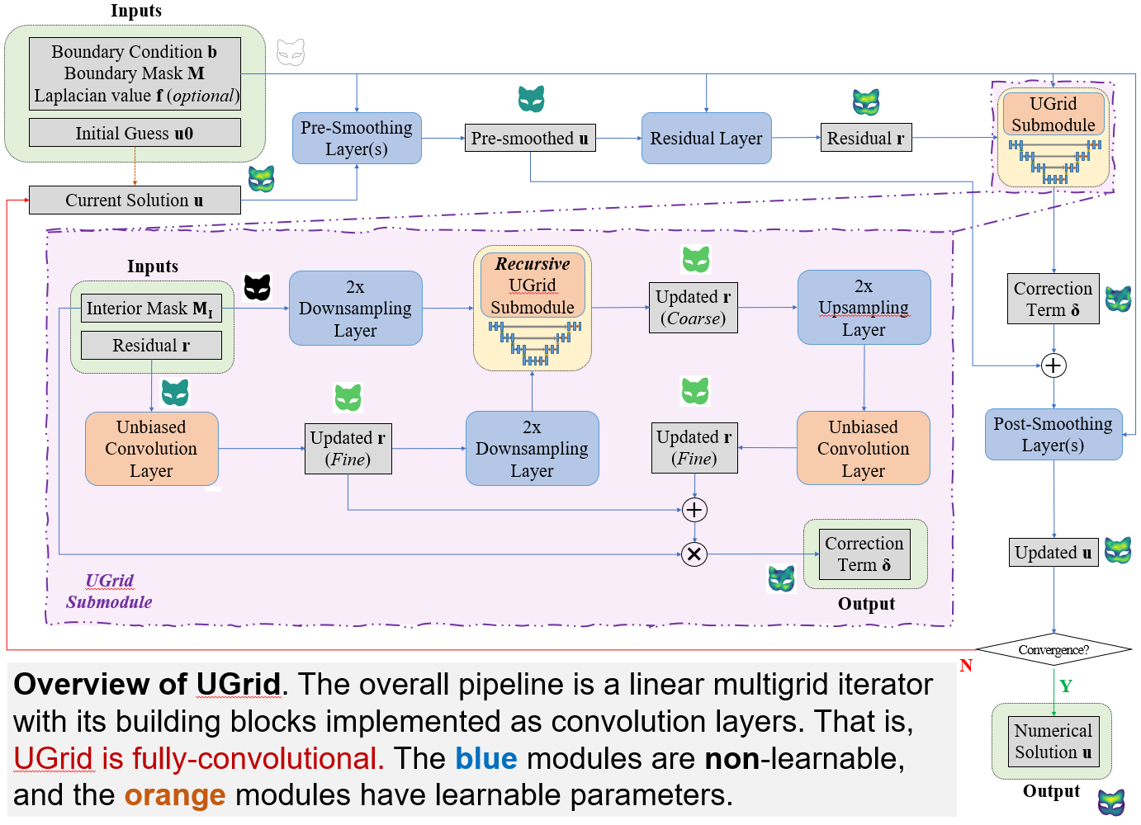

Slide 10
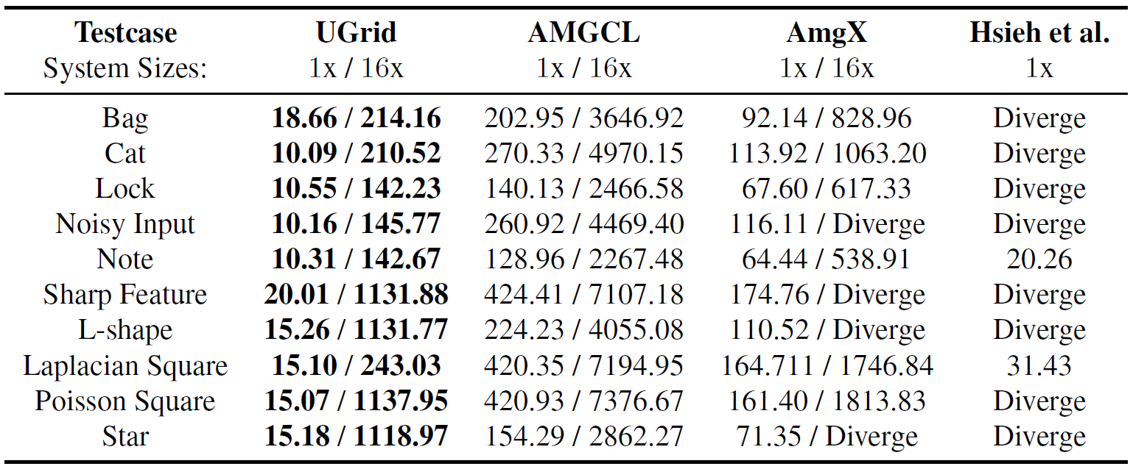
Ugrid: An Efficient-And-Rigorous Neural PDE Solver (ICML 2024)
Evaluation
Significant speedup over both legacy and neural routines and high scalability without need for retraining
Ablation studies showcase the effectiveness of the UGrid architecture and the proposed residual loss
High robustness over noisy inputs, and easy generalization to unseen RHS (values, geometries and topology)
Testcase coverage over 2D Poisson, Helmholtz, and Steady-state Diffusion-Convection-Reaction problems

Slide 11
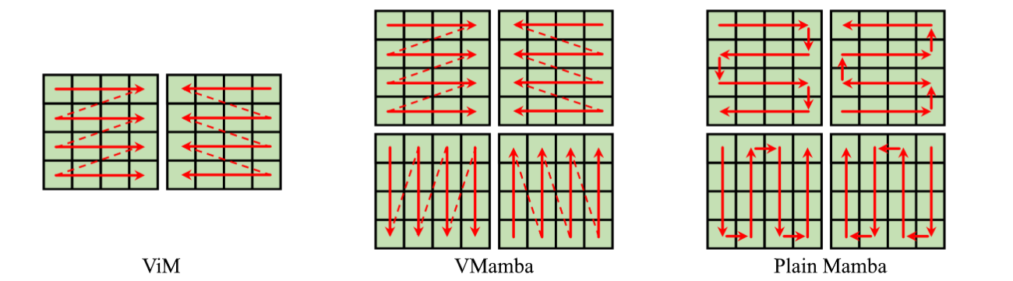
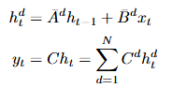
2dMamba: Efficient & Geometry-Aware SSM With Applications in Image Processing (CVPR 2025)
TL;DR. 2DMamba is a hardware-aware efficient multi-head selective scan architecture suitable for multiple upstream CV tasks.
Motivation: Limitations of current Vision Mamba architecture:
Intrinsically current Mamba can only process 1D sequence
Existing Mamba-based methods consider a 2D image as a 1D sequence of patches/tokens.
Some model 2D structure by using various scanning methods at the same time
But all of them are intrinsically 1D

Slide 12
2dMamba: Efficient & Geometry-Aware SSM With Applications in Image Processing (CVPR 2025)
Motivation: Limitations of current Vision Mamba architecture (Continued):
Some previous works proposed using 2D State Space Model for images,
But they can not leverage mamba’s fast parallel scan algorithm (thus slow)
Unlike mamba, their As and Bs does not depend on selective states (lower performance).
Our Contributions:
We propose a 2D-Mamba formula that directly model images as a 2D matrix, instead of flattening into a 1D patch sequence.
We propose a 2D parallel scan algorithm with a 2D tiling and caching mechanism and its CUDA implementation to optimize training/inference efficiency.
We propose learnable tokens to pad non-tissue regions.
We are the 1st intrinsic 2D SSM with hardware-aware multi-head parallel scan mechanism.

Slide 13
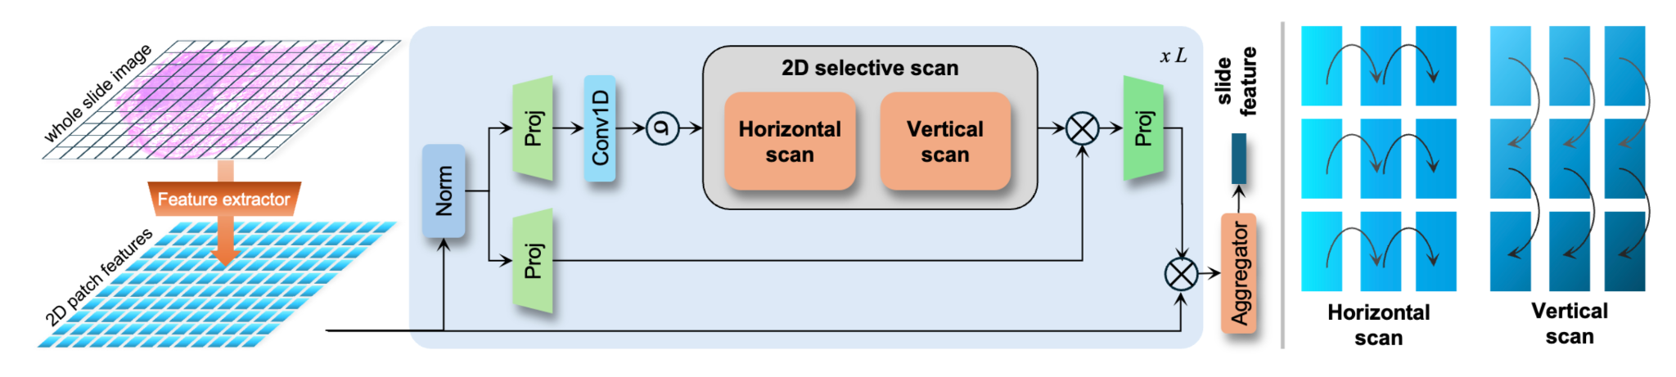
2dMamba: Efficient & Geometry-Aware SSM With Applications in Image Processing (CVPR 2025)

Slide 14
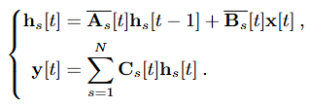
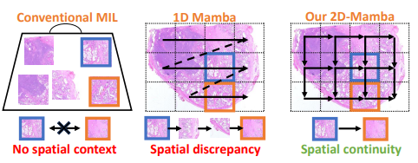
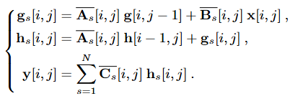
2dMamba: Efficient & Geometry-Aware SSM With Applications in Image Processing (CVPR 2025)
Vanilla Mamba:
Our 2DMamba:

Slide 15
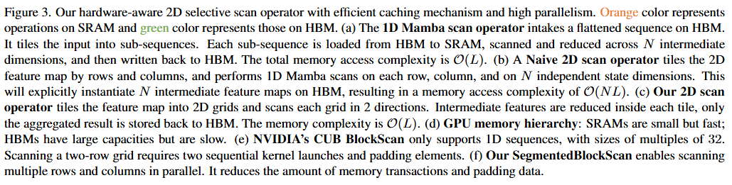

Slide 16
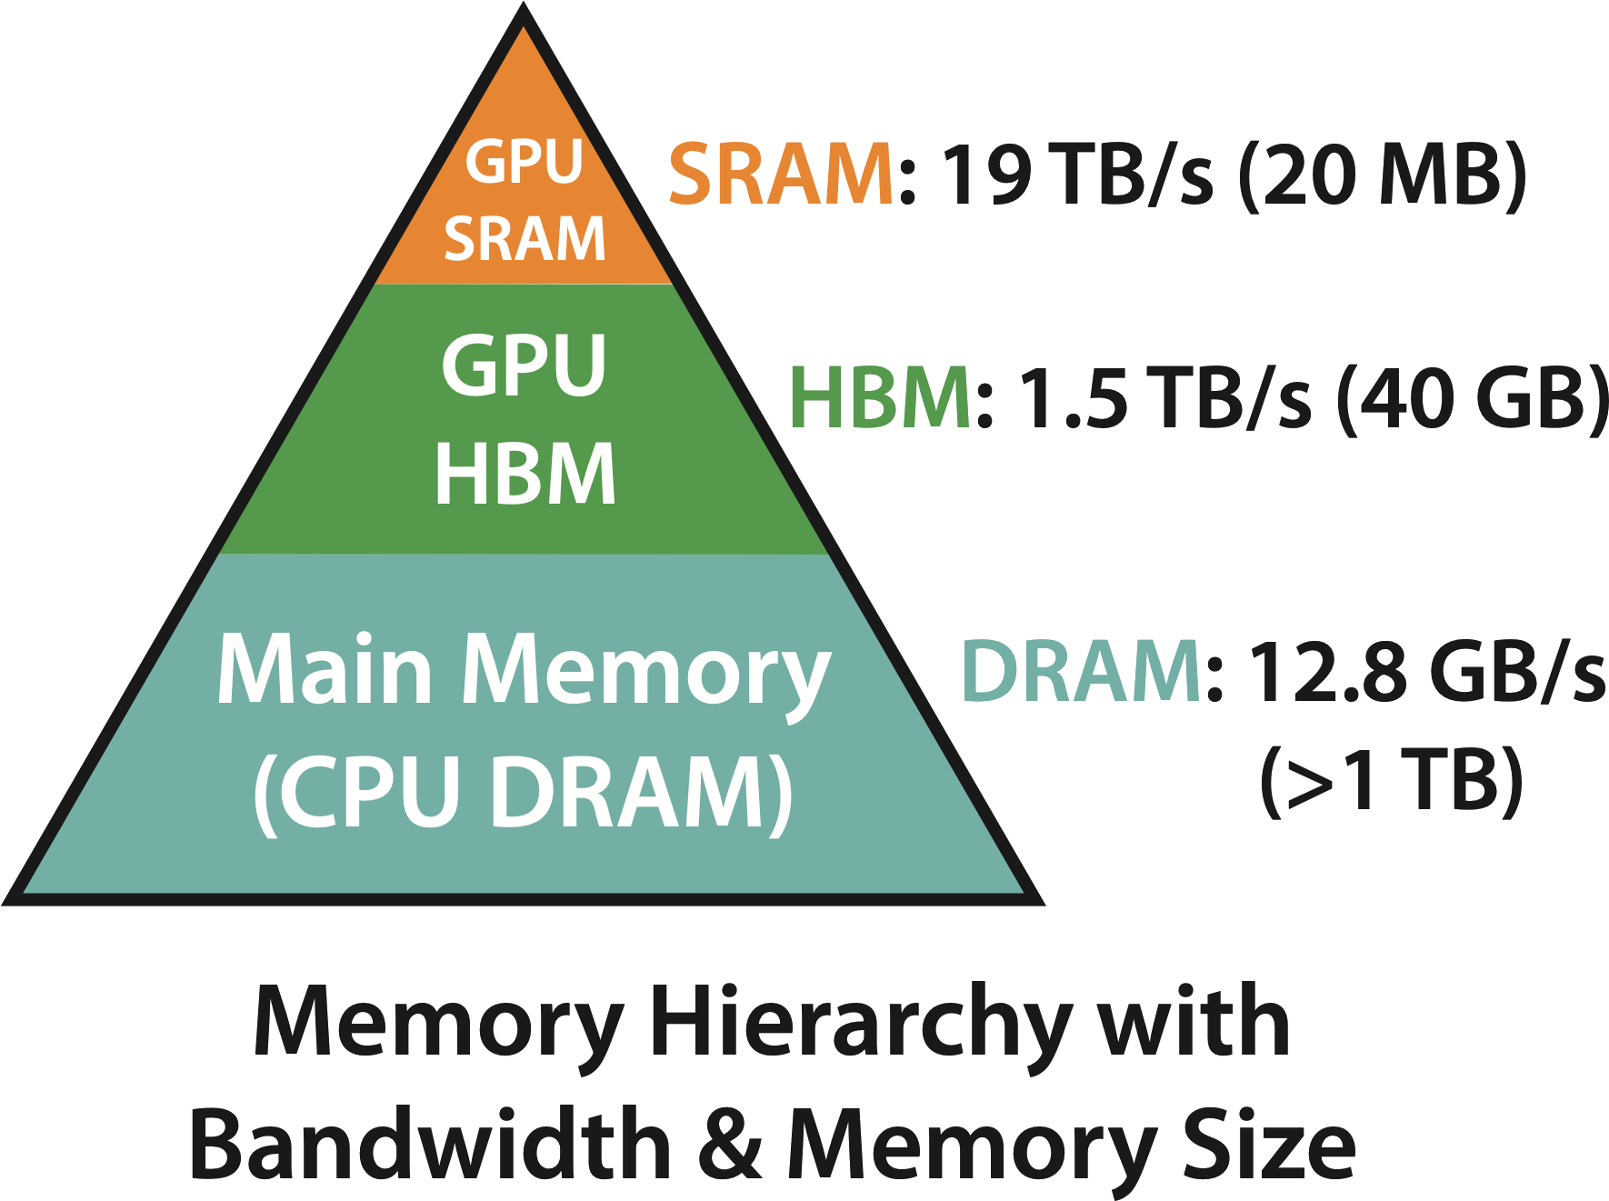
Ours: 2D Caching And Tiling
Each state depends on its left state and upper state, it can be stored without much burden
Hor and Ver scan
One chunk
Load to SRAM/ register
A matrix in HBM
2D chunk
(1) We fuse all heads in selective scan and head-wise reduction into one concrete kernel. We avoid explicit instantiation of per-head intermediates and save a lot of memory during backward pass.
(2) Inside each 2D tile, we conduct 2D warp scan (with prefix callbacks).
(*) Our implementation is hinted by the NVIDIA CUB library. All details are re-implemented from scratch (unlike vanilla mamba which could utilize CUB, 2D scans are not supported by CUB.)
Write back

Slide 17
Naïve 2D Scan -- Breakdown
Step 1.
Nvidia CUB library only allow parallel scanning one continues sequence.
Hor scan
One chunk
Load to
SRAM/ register
Write to a new matrix
An image in HBM
Tile horizontally
Ver scan
Load to SRAM/ register
N “heads”
Tile vertically
One chunk
Step 2.

Slide 18
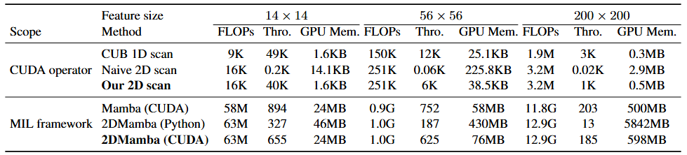
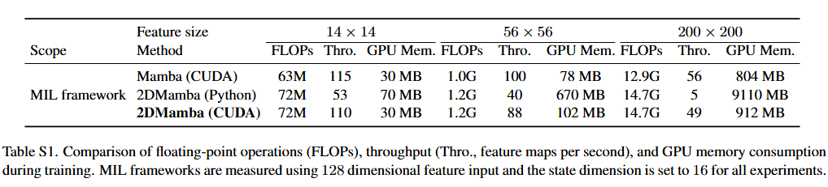

Slide 19
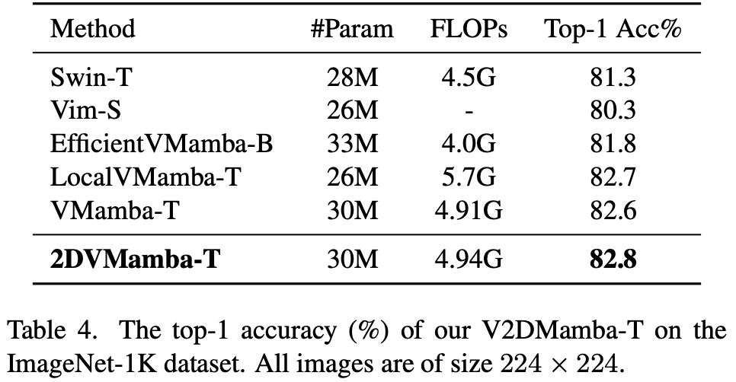
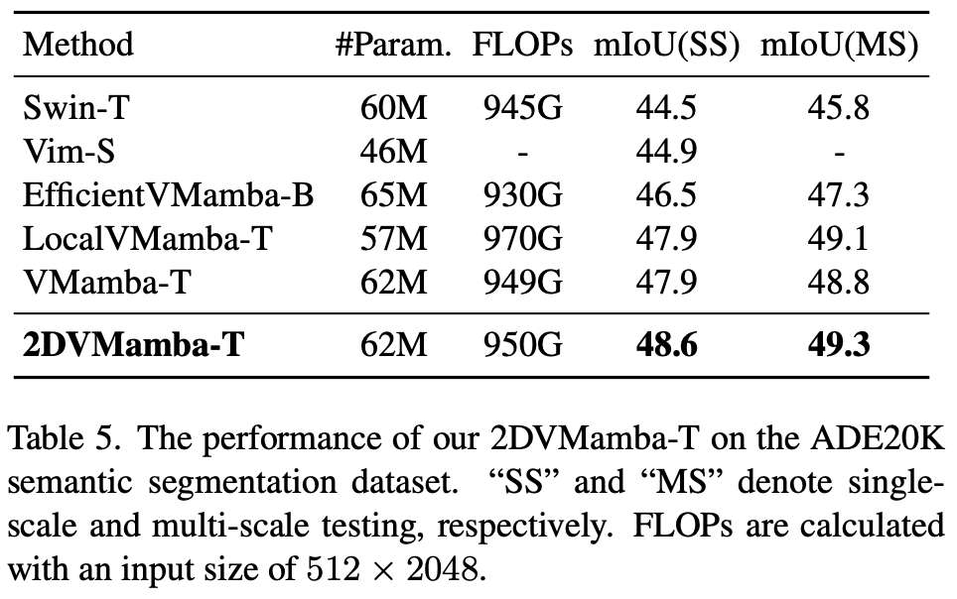
2dMamba: Performance (Natural Images)

Slide 20
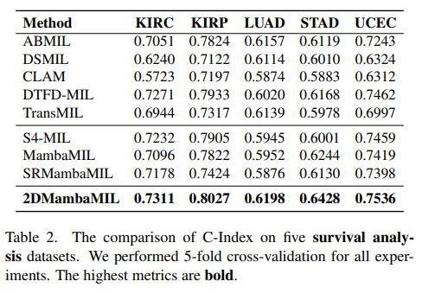
2dMamba: Performance (Medical Images)

Slide 21
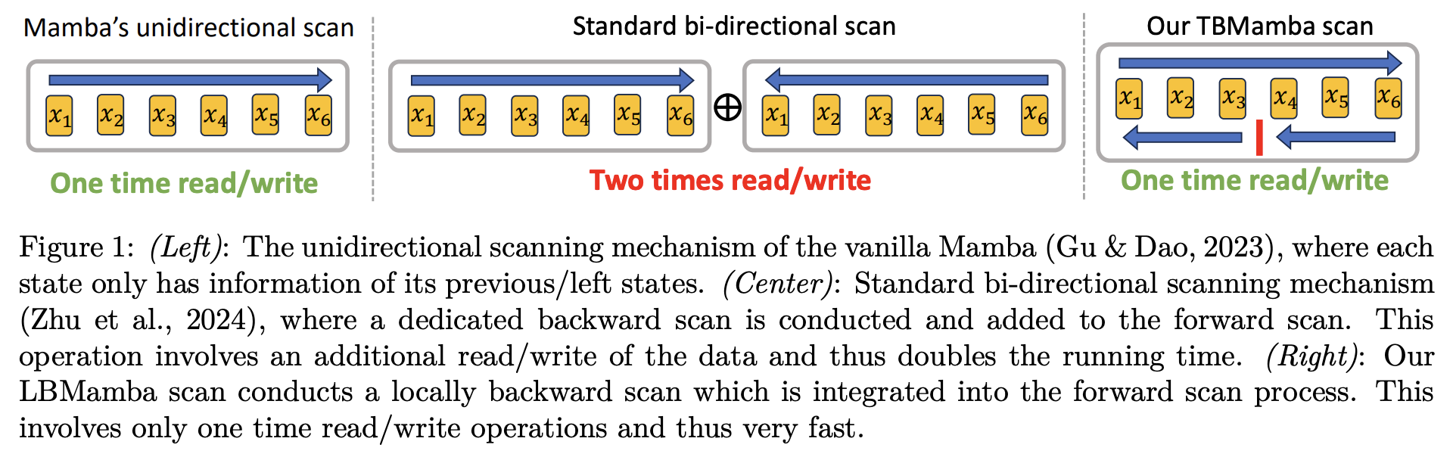
LBMamba: Locally Bi-directional Mamba
TL;DR. LBMamba is a hardware-aware bidirectional Mamba operator, which enhances Mamba-based foundational models by fusing forward and backward scans into one concrete GPU kernel.

Slide 22
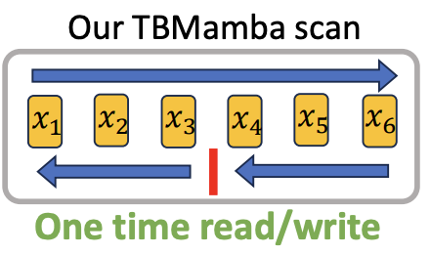
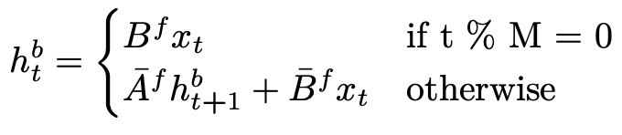
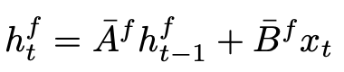
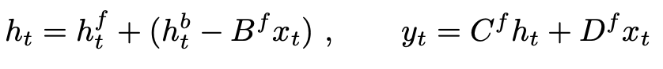
LBMamba: Mathematical Formulation
Local backward scan:
Forward scan:
Bi-directional result:

Slide 23
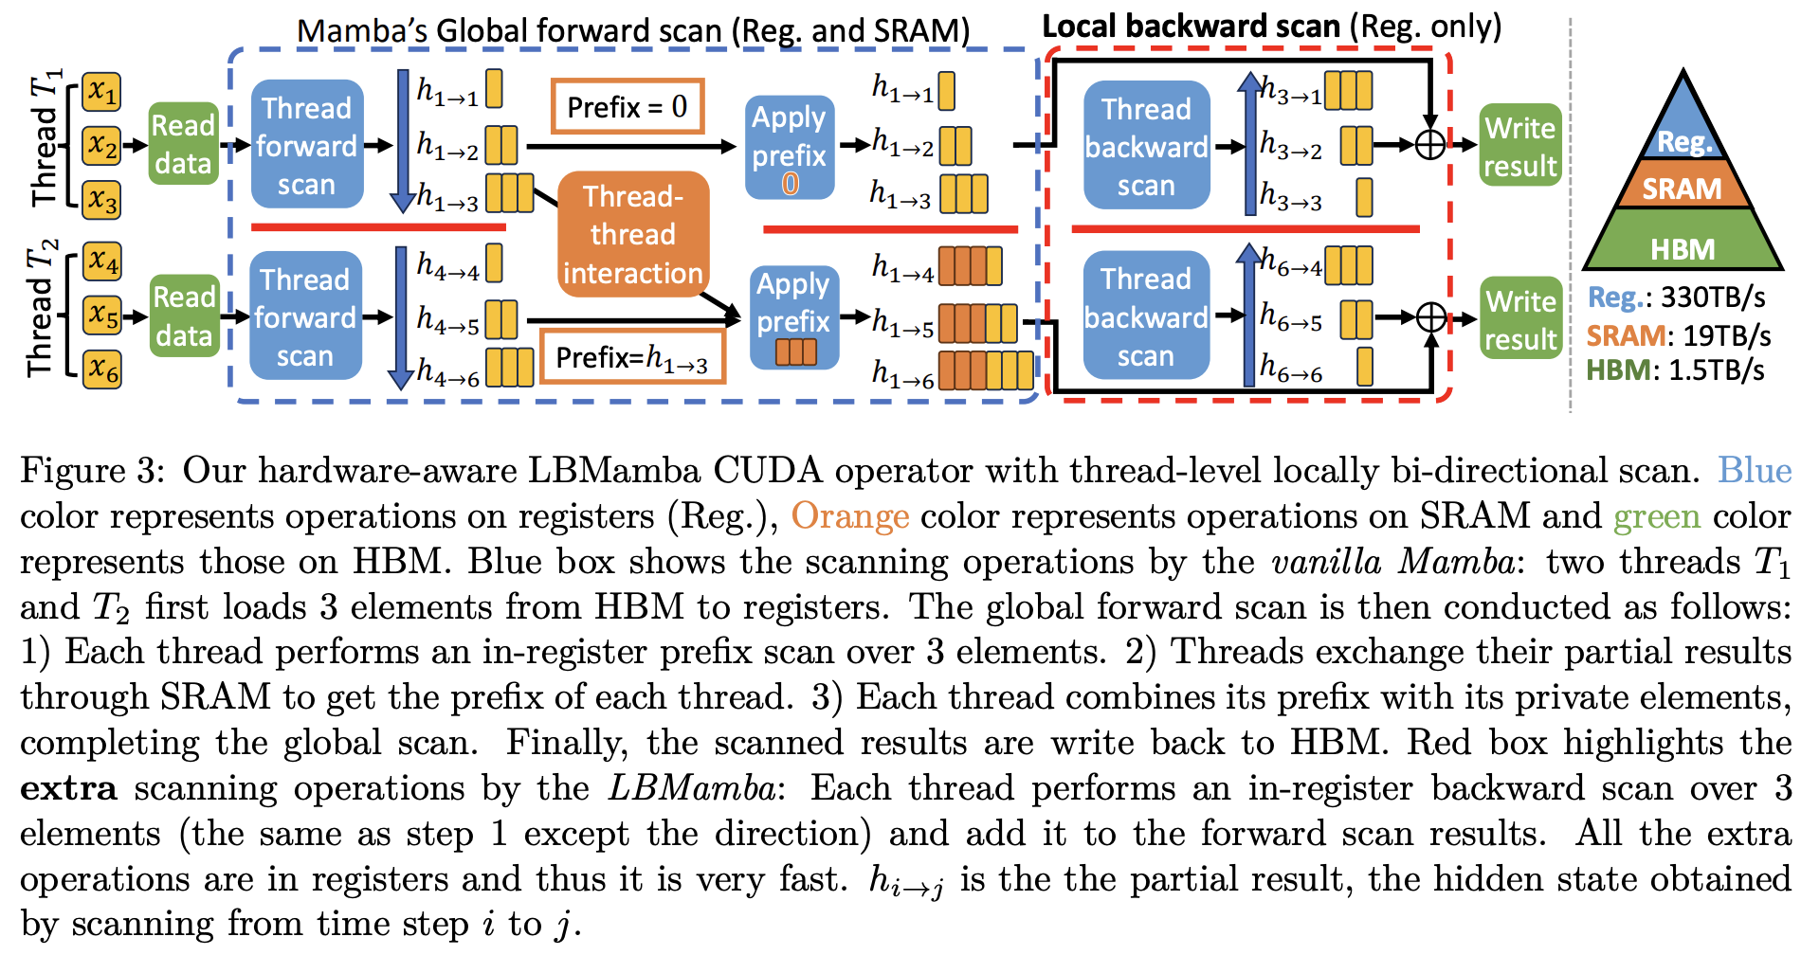
LbMamba: GPU Kernel

Slide 24
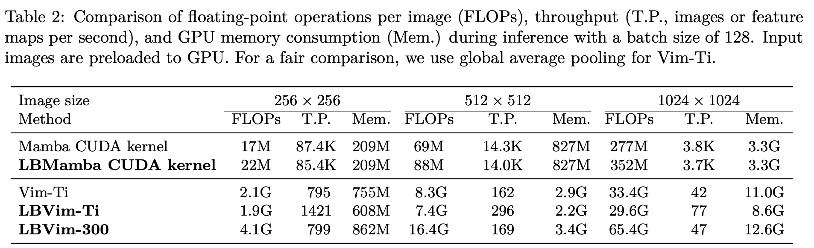
LBMamba: Efficiency
In practice, Mamba CUDA kernel must be invoked TWICE (forward and backward scans), while our LBMamba CUDA kernel is invoked only ONCE.

Slide 25
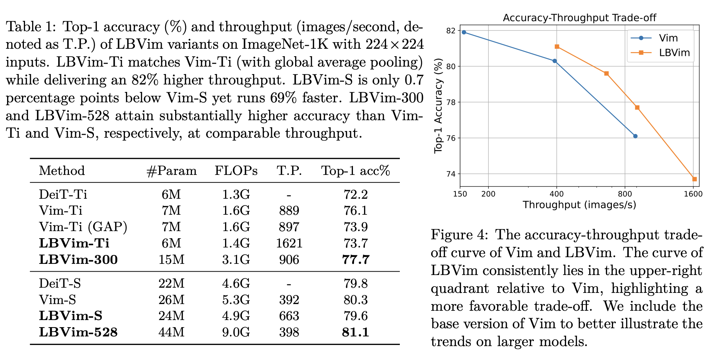
LBMamba: Performance (Classification)

Slide 26
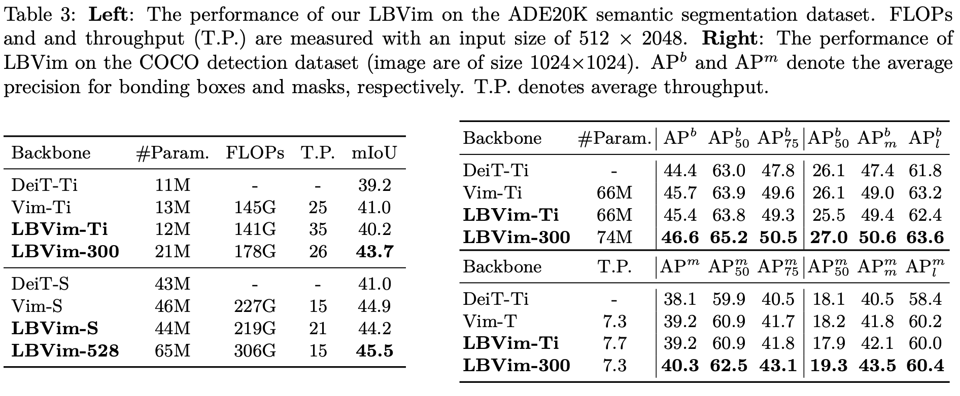
LBMamba: Performance (segmentation)

Slide 27
GeoMaNO: Geometric Mamba Neural Operator for PDEs
TL;DR. GeoMaNO is a Mamba-based neural operator framework with geometric rigor and mathematical insights, which could be used to solve Partial Differential Equations (PDEs).
(*) Ongoing research effort
Motivation. Current Transformer-based neural operators lack geometric rigor on regular grids, and suffer from quadratic complexity.
Mamba framework has modeling capability in par with Transformers, yet with a linear complexity.
Existing neural operators focus on irregular domains, leaving regular grids largely unexplored.

Slide 28
GeoMaNO: Geometric Mamba Neural Operator for PDEs
A novel GeoMamba-SSM formulation
A geometrically rigorous state-space representation;
Preserves the geometry of the input domain;
Employs a learnable geometric correction component to dampen duplicate hidden states arising from multi-way cross-scans.
A novel GeoMaNO architecture
Utilizes GeoMamba-SSM's geometric rigor to approximate PDE solution operators
Offers users high efficiency, high accuracy, high scalability, and high generalization power.
Superior performance surpassing SOTA by as much as 58.9%.

Slide 29

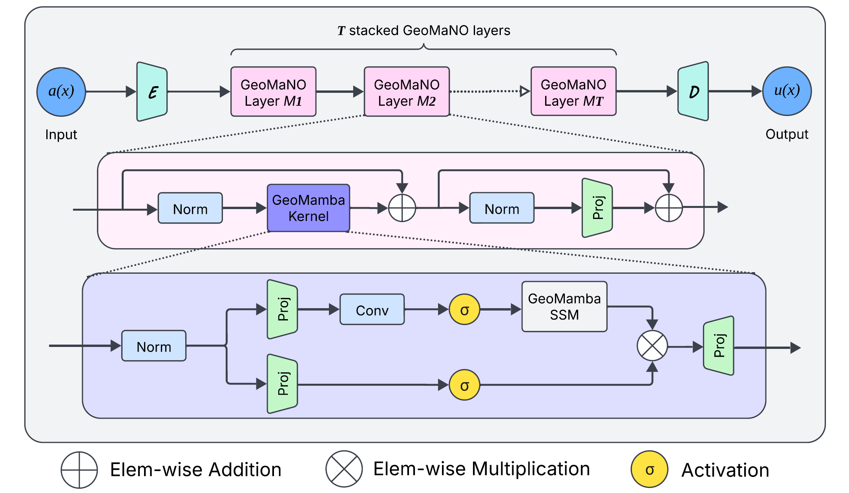
GeoMaNO: Architecture

Slide 30
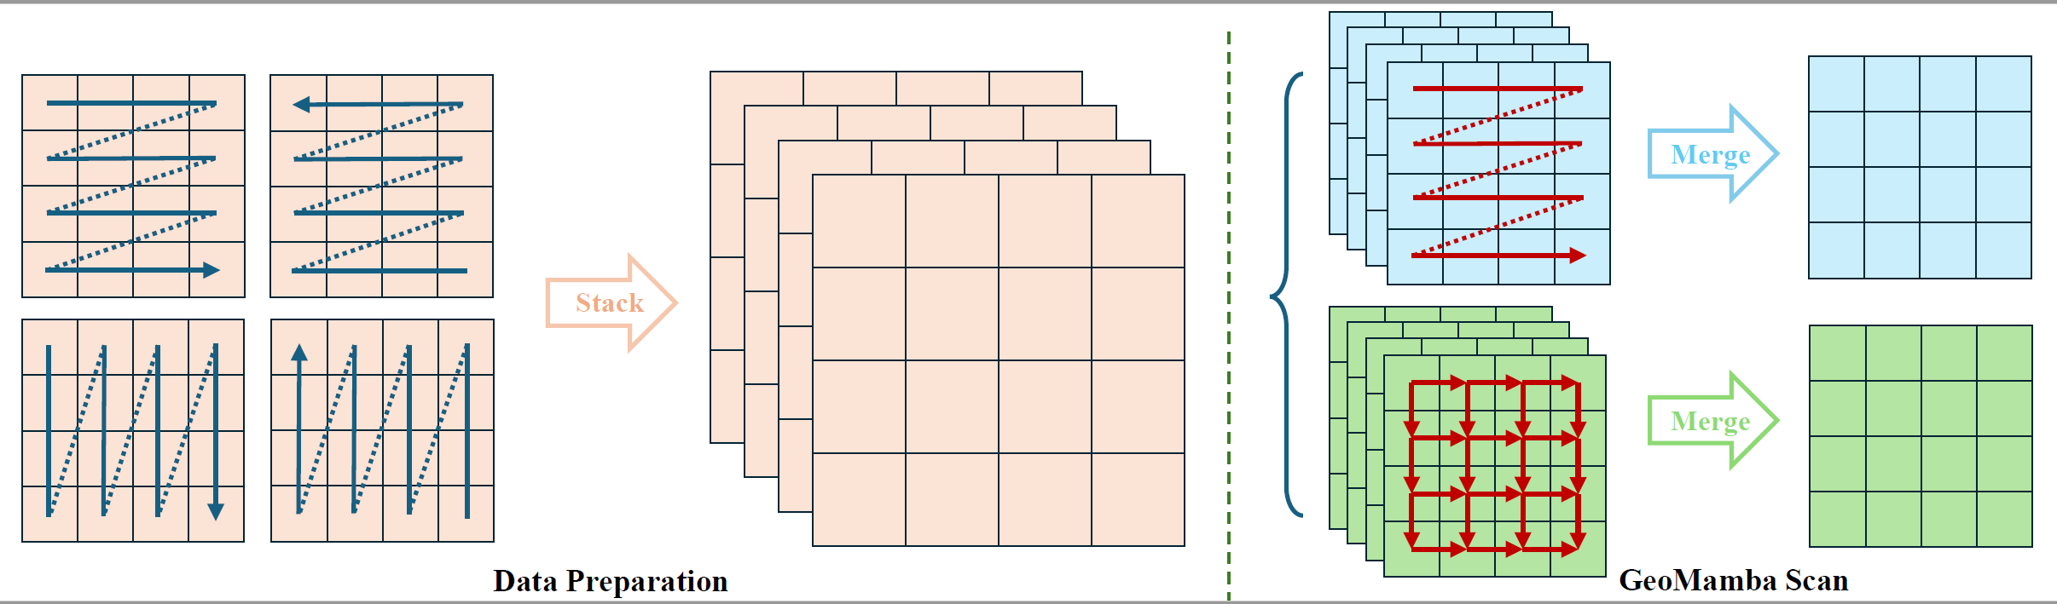
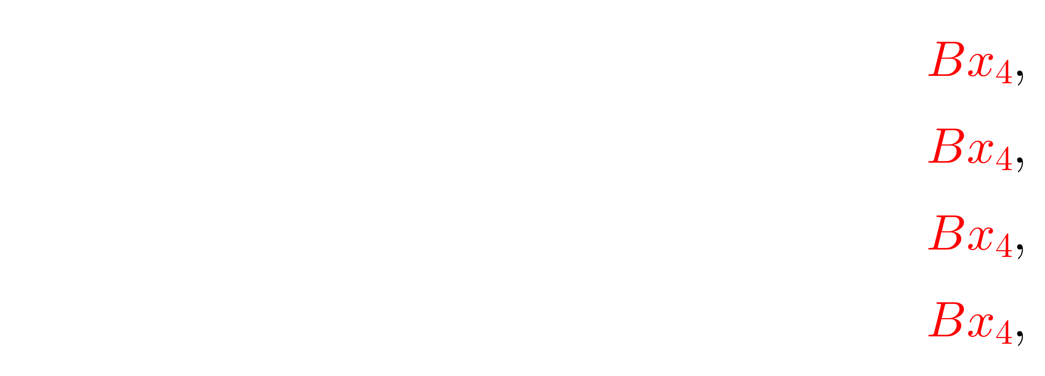

GeoMaNO: Insights (1/2)
The cross-scan pattern (above) introduces duplicate hidden states!
The hidden state Bx4 is duplicated four times!

Slide 31
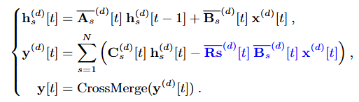
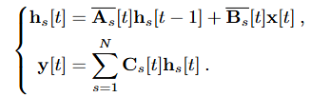
GeoMaNO: Insights (1/2)
Our novel GeoMamba-SSM formulation utilizes a geometric correction term to dampen these duplicate hidden states!
GeoMamba-SSM manifests a hardware-aware design to maximize Mamba-based operations’ efficiency.
Left: Vanilla Mamba-SSM;
Right: GeoMamba-SSM.

Slide 32
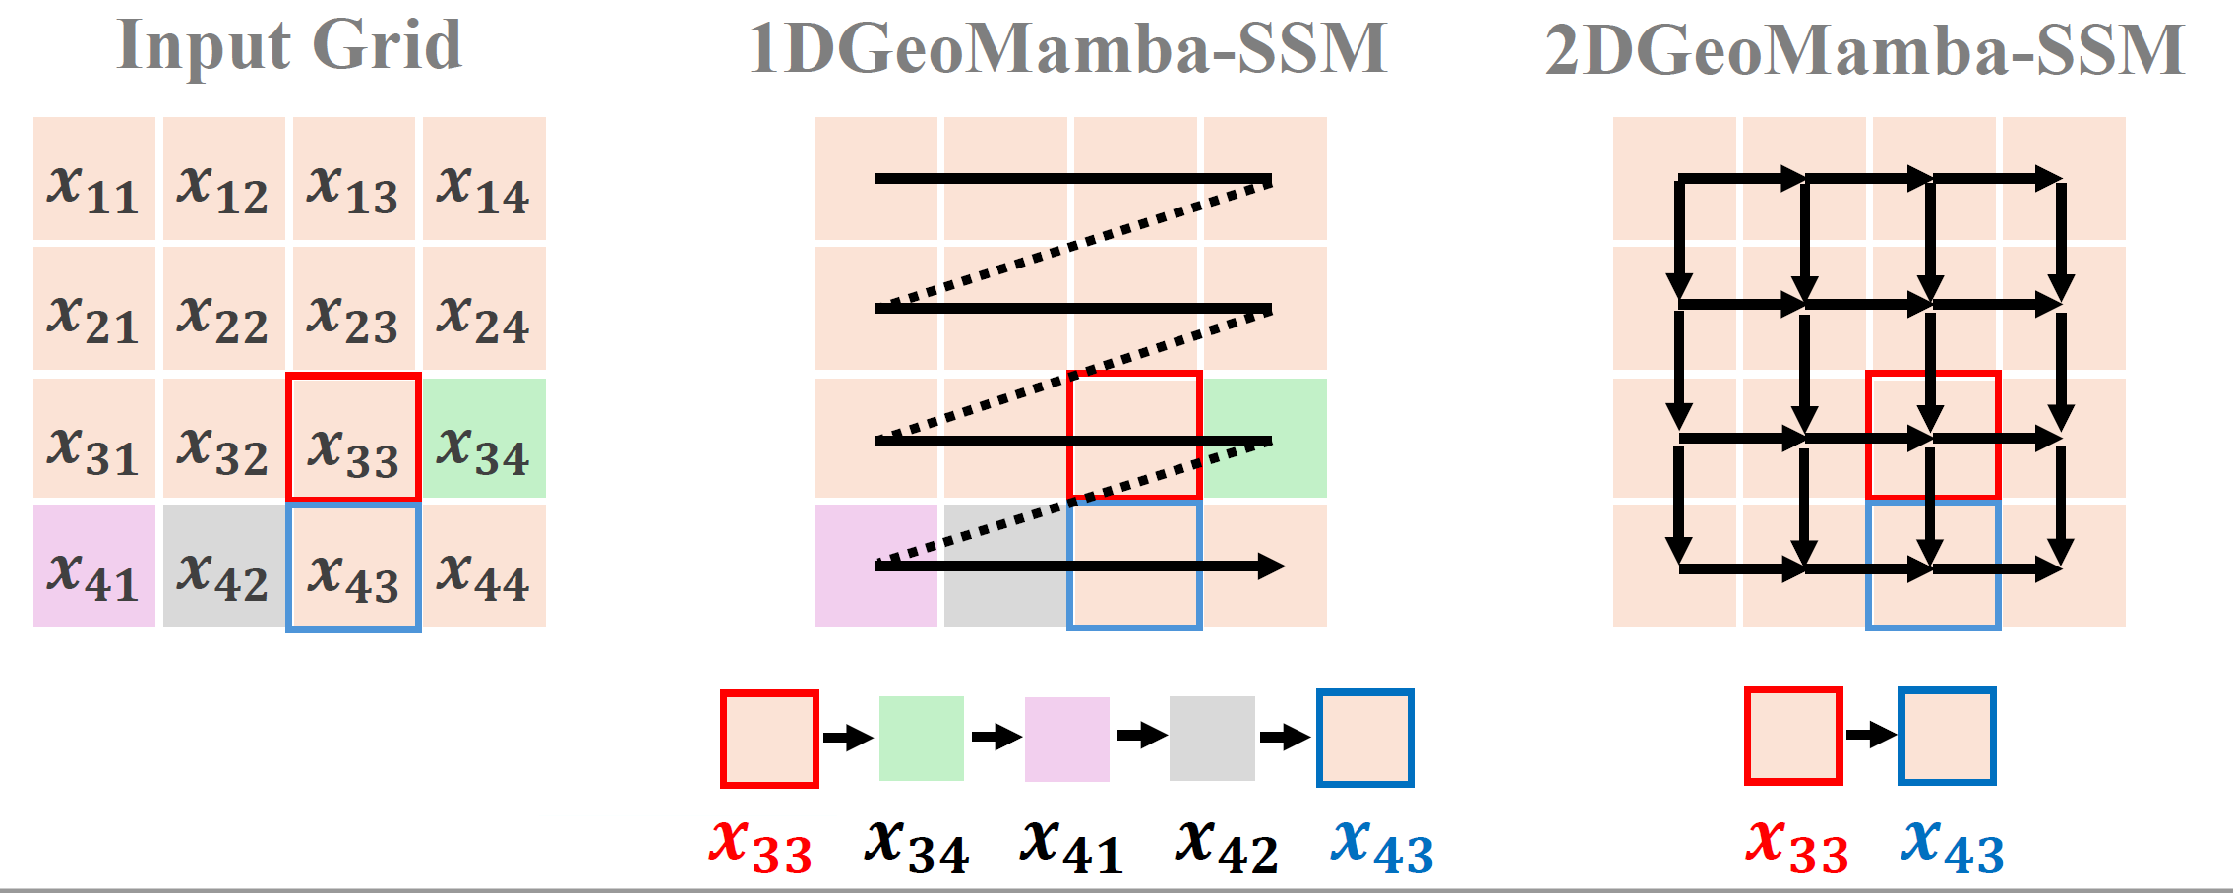
GeoMaNO: Insights (2/2)
The vanilla Mamba formulation results in geometric inconsistency on 2D domains!

Slide 33
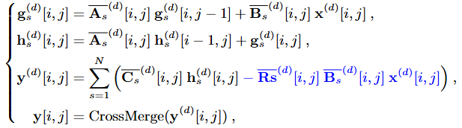
GeoMaNO: Insights (2/2)
Our novel 2DGeoMamba-SSM formulation:

Slide 34
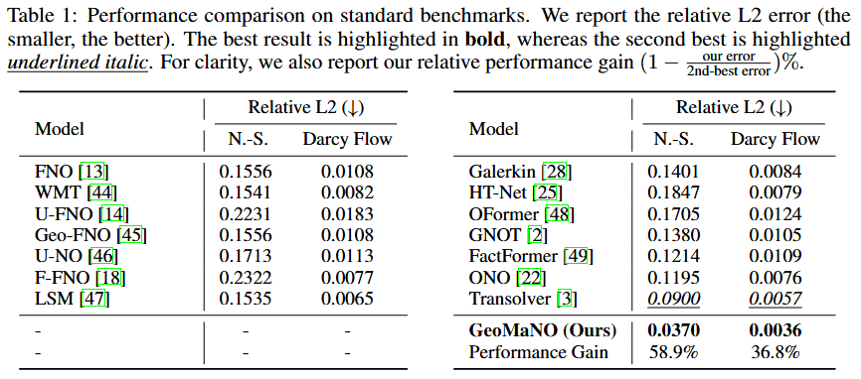
GeoMaNO: Superior Performance

Slide 35
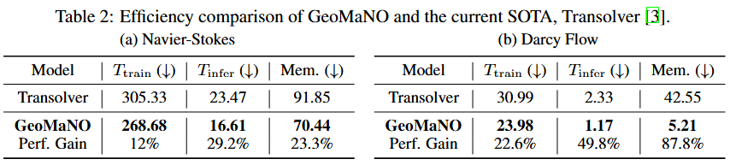
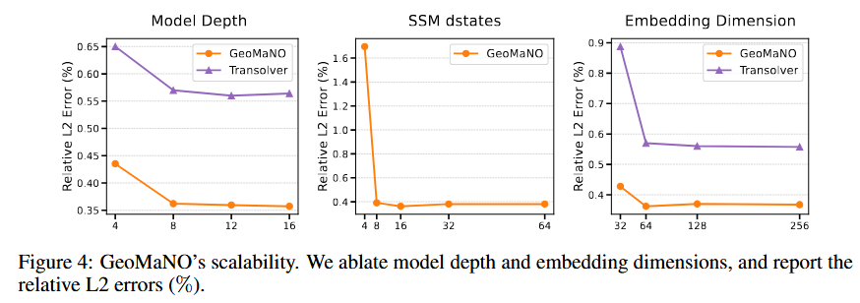
GeoMaNO: Superior Performance

Slide 36
DiffPVG: Physics-Informed Differentiable 3D Poisson Vector Graphics
TL;DR: DiffPVG is a fully-differentiable Poisson solver which gaps the raster and vector spaces, and could be used for intelligent creation and manipulation of Poisson Vector Graphics.
(*) Ongoing research effort
Motivation: There is a gap between vector graphics and raster graphics.
Poisson Vector Graphics (PVG) is a rigorous vector graphics representation backboned by Poisson’s equations;
Legacy raster-graphics-based routines could not be applied to vector contents (and on PVG);
DiffPVG gaps this two domains by differentiating raster losses onto PVG primitives.

Slide 37
DiffPVG: Physics-Informed Differentiable 3D Poisson Vector Graphics
We propose a fully-differentiable Poisson equation solver, which is differentiable w.r.t. boundary geometry.
We segment a Poisson problem with complex boundary geometry into two sub-problems:
A Poisson equation with simple boundary, and
A Laplacian equation with actual boundary
These two sub-problems have closed-form solutions and supports back-propagation from raster loss to vector graphics control nodes.
The forward and backward operators are not typical NN operators and requires manual design and implementation on CUDA platform.

Slide 38
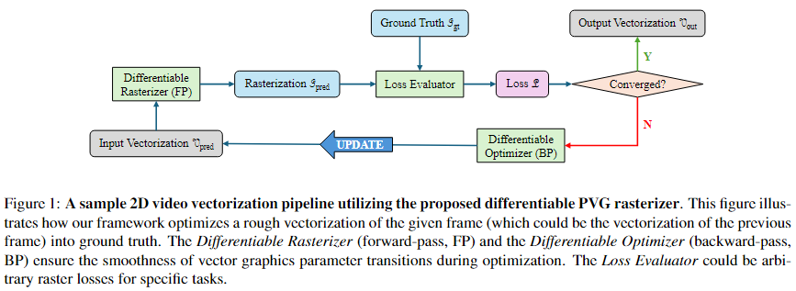
DiffPVG: Physics-Informed Differentiable 3D Poisson Vector Graphics

Slide 39
DiffPVG: Physics-Informed Differentiable 3D Poisson Vector Graphics
Implementation Considerations
Trait-based implementation offers maximum optimization chances to compiler;
Literal values are passed-in as traits and dispatched to reduce runtime loads;
Manual implementation of CPU-only routines, including Monte-Carlo integration over Green’s functions, computational geometry routines, etc, on CUDA platform;
These routines are typically CPU-only, and unavailable on CUDA.
Warp divergence is inevitable for these non-typical routines, yet memory optimization is available
Fully CUDA-based, no CPU-HBM transfers;
Vectorized loads/stores for 2D coordinates;
Cache optimizations are conducted when bank conflicts are detected.

Slide 40
Baseline CUDA Algorithms
Implemented many baseline parallel algorithms in CUDA. Selected kernels:
Block Reduction (Raking/Warp-shuffle variants, with loop unrolling and vectorized memory access)
Matrix transpose
Fused softmax/LayerNorm/RMSNorm
Im2col
Block Parallel Scan (Warp-Shuffle variant)
SGEMM
Reaches 90% performance (avg over 100 times) of cuBLAS on 4096x4096x4096 FP32 GEMM
Bank conflict considerations: Padding and warp tiling (transposed/z-tiling) optimizations
Double buffer optimization

Slide 41
Xi Han
Education:
B.E. in Computer Science (Tsinghua University, 2015).
Ph.D. in Computer Science (Stony Brook University, expected by 2026).
Skills:
C/C++/CUDA/PTX, GPU Algorithms, Mamba, PDEs, Computer Graphics, Machine Learning.
Research Projects:
UGrid: Neural PDE solver with convergence guarantee (ICML 2024).
2DMamba: 2D Mamba scanner with hardware awareness and applications in image processing (CVPR 2025).
LBMamba: Bidirectional Mamba scanner with hardware awareness and apps. In image processing (Under review).
GeoMaNO: Geometry and hardware-aware Mamba Neural Operator for solving PDEs (Under review).
DPR: Differentiable Poisson solver with hardware awareness and apps. in Computer Graphics (Ongoing).
Other Projects:
Fine-tuning of multiple AI/ML/GPU operators (CUDA kernels).

